Slide 1
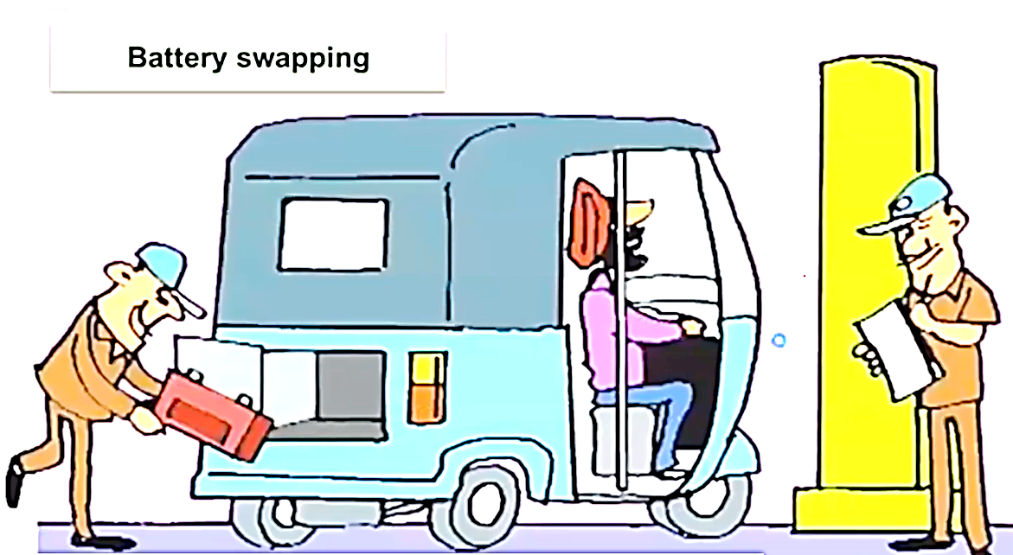

Slide 2
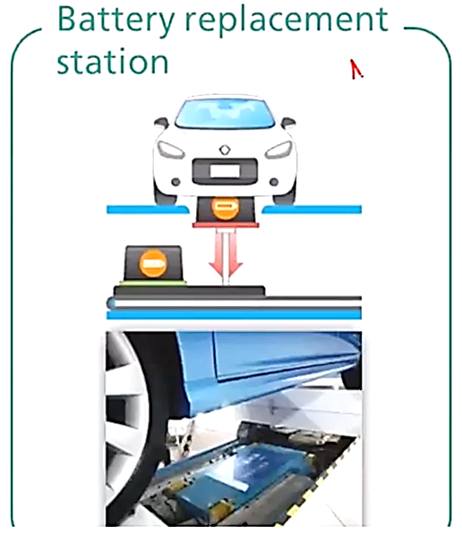
Types of EV Charging : Battery Swap
Aside from quick charging via direct current (DC), battery replacement is the only other option to overcome the range limits of electric vehicles at the moment.
This is how it works:
• If an electric vehicle is running out of energy, the driver can drive into a battery replacement station.
• In the station the empty battery is replaced by a full battery automatically.
• Some E Vs are specifically designed with a battery interface that is compatible with this charging concept.

Slide 3
Advantages and challenges battery swapping
Advantages | Barriers
EV. recharging is completed in minutes | Lack of standardization among Ev batteries
Batteries can be charged away from swapping point. allowing more freedom in setting up swap facilities | Unsuitable battery pack design to enable ease of swapping (weight. dimensions and ergonomics)
Reduction in upfront cost Of EV. as battery ownership is replaced by battery leasing | Greater number of batteries needed to power number Of EVs
Increased predictability of battery life due to controlled charging conditions | Shorter commercial life of battery packs due to customer preference for new batteries With higher range
 | Slow adoption of charging method by OEMs
 | Higher costs of battery leasing over the life Of the EV
 | Higher GST on separate battery (18%) vs battery sold With EV (5%)

Slide 4
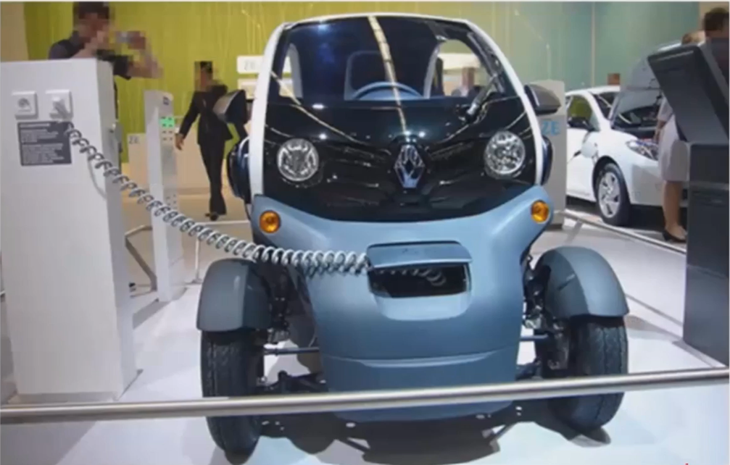

Slide 5
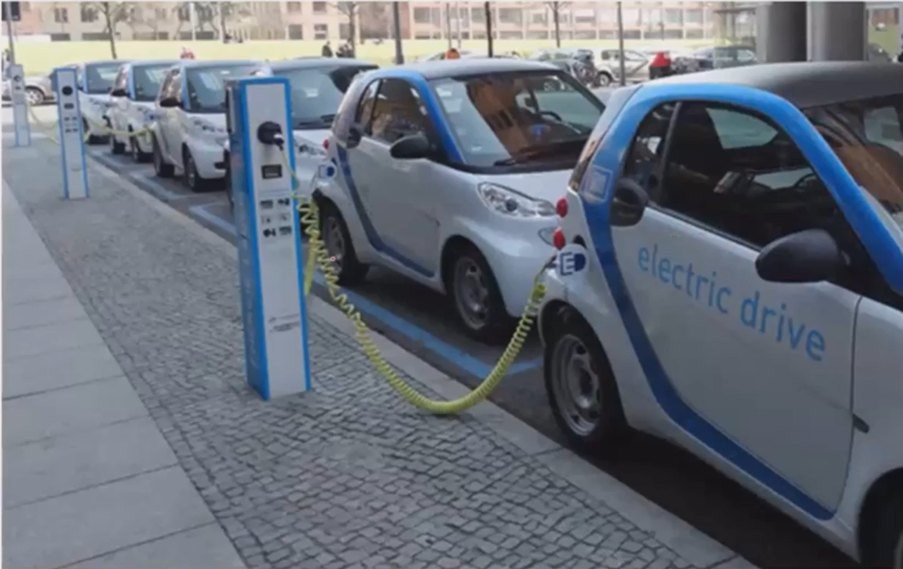

Slide 6
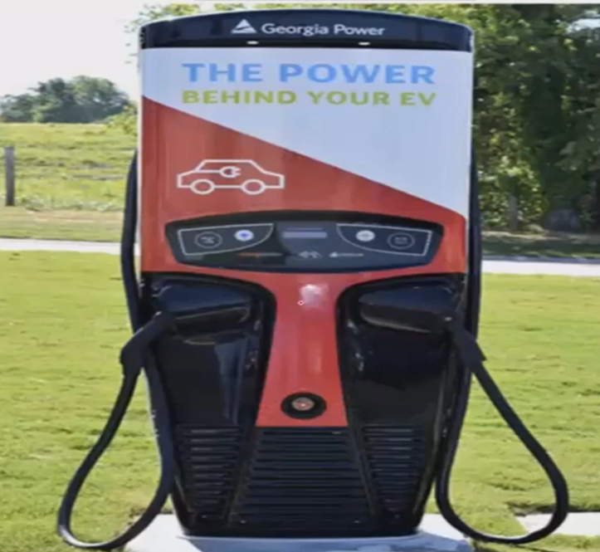

Slide 7
EV Charging Standards for interoperability
Indian Standards for AC Charging
IS-17017
IS-17017-Part 1
IS-17017-Part 2
Indian Standards for DC charging
• IS-17017-Part-23
• IS-17017-Part-24
• IS-17017-Part25
INDIAN STANDARDS FOR BATTERY SWAPPING

